Slide 1
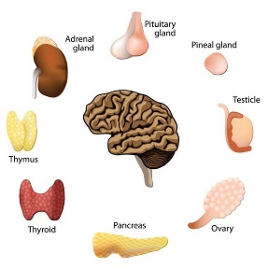
University of Basrah Ministry of Higher education Al-Zahraa Medical College and Scientific Research
Block: Metabolic block
Lecture:
Lecturer:
Block staff:
Dr.Ahmed jaafer (block leader) Dr.Ahmed qasim Dr. Majid hameed
Dr. Daihgum imad Dr.Ahmed ibraheem Dr. Mohammed mehdi Dr .Ammar mohammed
Davidson's Principles and Practice of Medicine
HARRISON’S PRINCIPLES OF INTERNAL MEDICINE
WILLIAMS textbook of ENDOCRINOLOGY
PEDIATRIC PRACTICE Endocrinology
Oxford Handbook of Endocrinology and Diabetes

